Slide 1
Postsecondary Outcomes Dashboard instructions
This dashboard can be found at
reportcard.ride.ri.gov

Slide 2
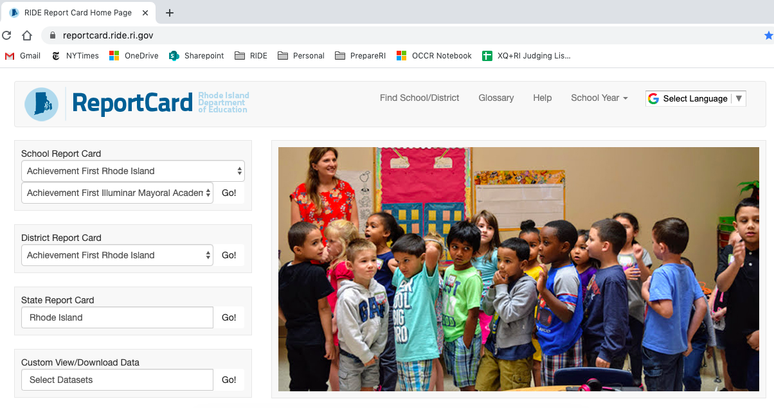
Postsecondary Participation Dashboard
Problem: High schools don’t know what happens to their students after they leave the K-12 system.
Solution: Include a postsecondary participation dashboard on RIDE’s report card site that makes that information available.
Navigate to reportcard.ride.ri.gov

Slide 3
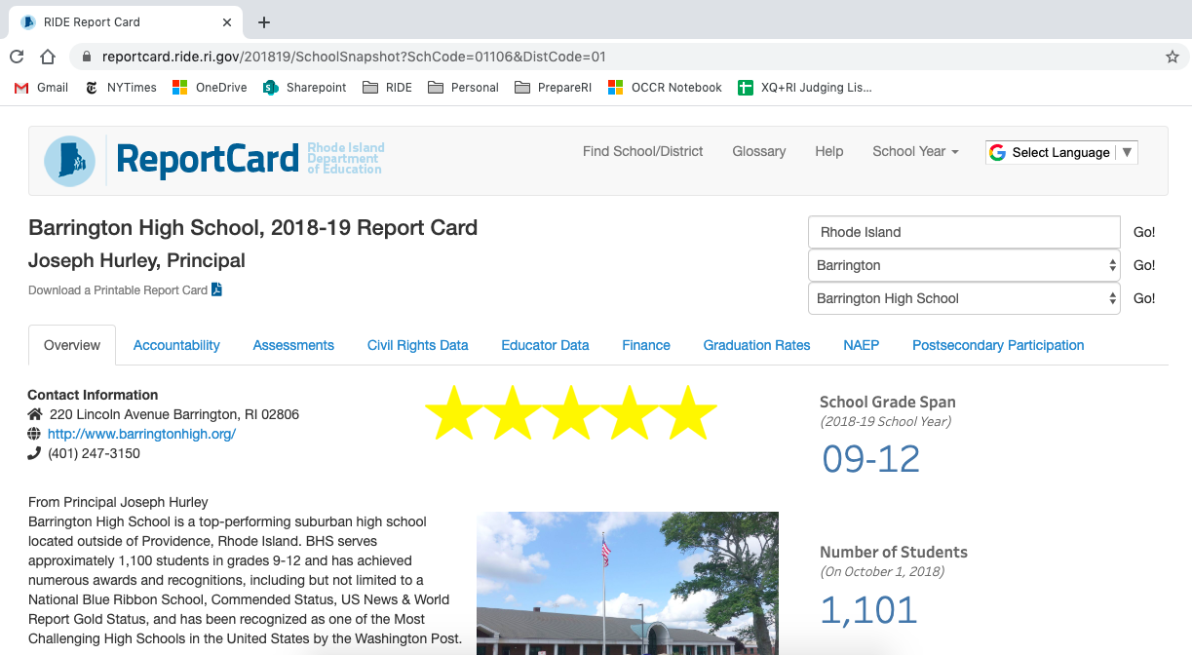
Postsecondary Participation Dashboard

Slide 4
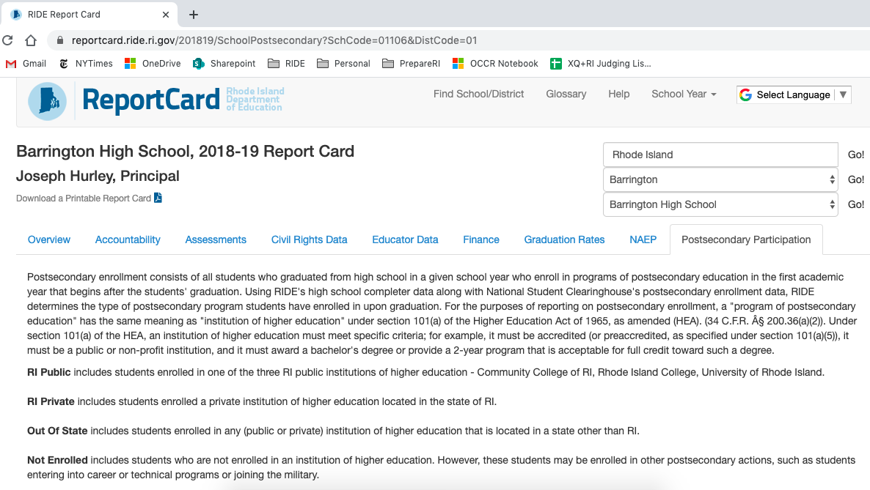
Postsecondary Participation Dashboard
There is intro text that describes the data set and includes postsecondary definitions

Slide 5
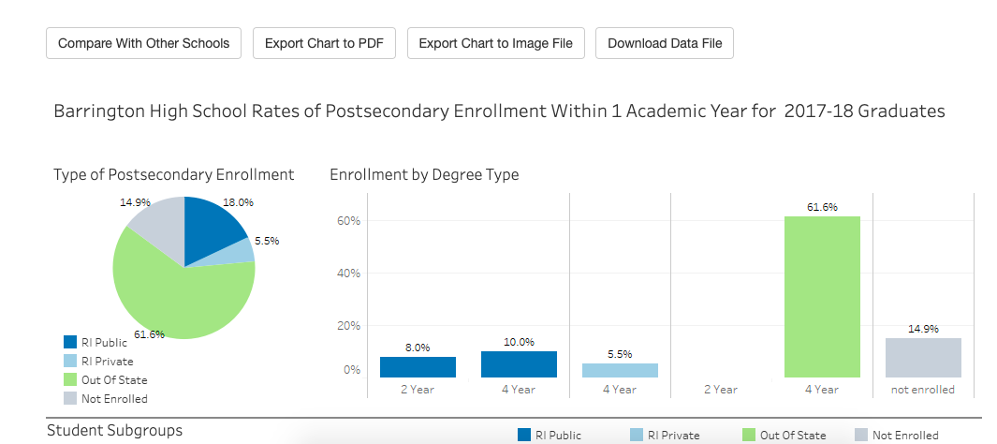
Postsecondary Participation Dashboard

Slide 6
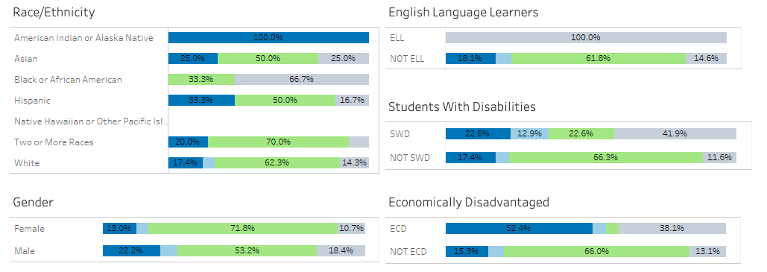
Postsecondary Participation Dashboard

