Slide 1
Career Coordinators Welcome Meeting
September 25, 2018

Slide 2
Agenda
9:00 – Introductions
9:10 – Background on PrepareRI
9:40 – Career Coordinators responsibilities
9:50 – Background on Skills for RI’s Future
10:00 – WaterFire Presentation
Break
10:30 – Work-Based Learning introduction
11:30 – Close

Slide 3
Introductions
Paul Williams, Office of College & Career Readiness, RIDE
Paul.Williams@ride.ri.gov
Spencer Sherman, Office of College & Career Readiness, RIDE
Spencer.Sherman@ride.ri.gov
Lynne Bedard, PrepareRI Ambassador & Career Coordinator, Ponaganset High School
lbedard@fgschools.com

Slide 4
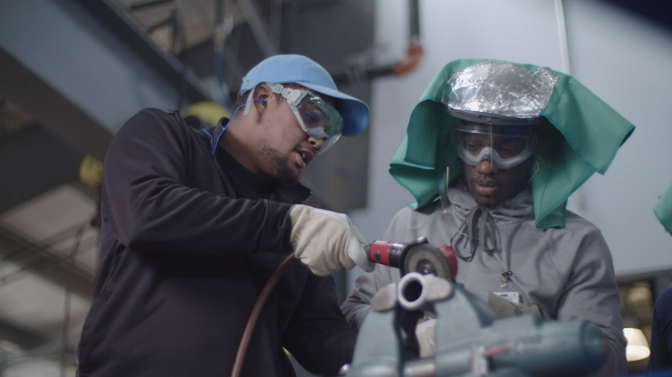
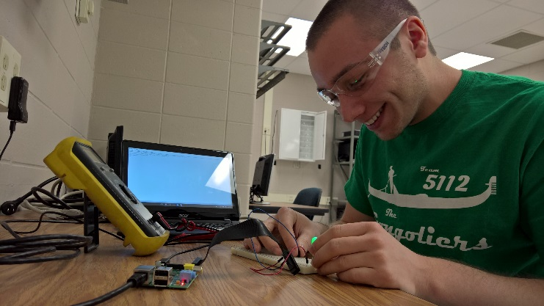
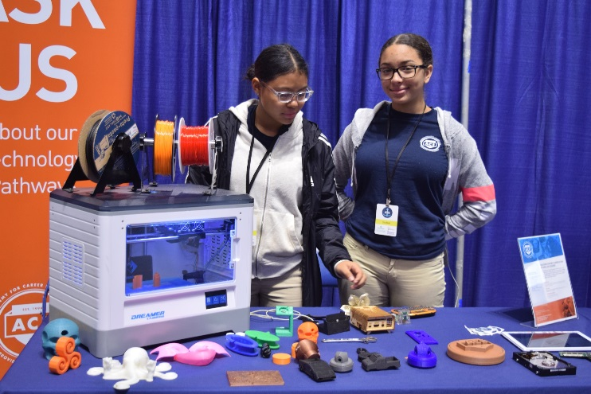
If you have the passion,
we have a pathway
www.Prepare-RI.org

Slide 5
WHAT is PrepareRI?
A statewide strategy to prepare all Rhode Island youth for success in college and career
A strategic partnership between government, private industry leaders, K-12 education, higher education, and non-profits across Rhode Island
An initiative funded, in part, by the New Skills for Youth Grant from JPMorgan Chase and the Council of Chief State School Officers (CCSSO)

Slide 6
WHY do we need PrepareRI?
By 2020, 70% of jobs in Rhode Island will require some postsecondary education, but currently, less than 45% of Rhode Islanders have that experience
For students, PrepareRI aims to close the gap between what they learn in school and what they need for high-demand jobs
For businesses, PrepareRI ensures that employers have the workforce they need to thrive in the economy of tomorrow

Slide 7
WHO is a part of PrepareRI?
PrepareRI is run by an inter-agency task force that includes:
Rhode Island Governor’s Office
Rhode Island Department of Education (RIDE)
Governor’s Workforce Board (GWB)
Rhode Island Commerce Corporation (Commerce)
Office of the Postsecondary Commissioner (OPC)
This task force partners with Rhode Island employers and communities so that we can leverage our collective strength to achieve our ambitious goals

Slide 8
Our Goals for 2020
Priority | Goals for 2020
Employer engagement | All career pathway programs will be aligned to Rhode Island’s high-demand career fields
Diploma Plus | Over half of high school students will graduate with college credit or an industry credential
Work-based learning | All high school students will have access to work-based learning at their school
Career & Technical Education (CTE) | Half of high school students will participate in a CTE program
Counseling and career exploration | All students in grades 6-12 will have individual learning plans (ILPs), informed by students’ experiences in career exploration programming
Outcome-focused accountability | Agencies will use data on students’ college and career outcomes to evaluate schools and programs
Aligned funding | Align funding streams around a common strategy for building career pathway programs for all students
Outreach and professional learning | All schools in the state will participate in PrepareRI professional learning

Slide 9
Key Program Components
Advanced Course Network (ACN): Catalogue of challenging, college-level courses offered by postsecondary institutions, school districts, and community partners.
Career and Technical Education (CTE): Career education offerings available at CTE centers and comprehensive high schools. In Rhode Island, there is open enrollment for CTE programming.
Computer Science for Rhode Island (CS4RI): Coalition-based and mixed delivery model approach to expanding computer science into every public school in the state.
Dual Enrollment: College courses offered on-site at CCRI, URI, and RIC.
Concurrent Enrollment: College courses taught at high schools by teachers who have been approved as college adjuncts.
P-TECH: Allows students to earn their high school diploma, an Associate’s Degree from CCRI, and a first-in-line job opportunity with a business partner.
PrepareRI Internship Program: Piloted in the summer of 2018, places rising high school seniors into paid summer internships with leading Rhode Island employers
Real Skills for Youth: Partnerships between industry and education that provide youth with paid summer work experiences and year-round career readiness activities

Slide 10
Early Success
since 2015…
38% increase in Advanced Placement participation
56% growth in CTE programs, for a record 203 approved programs
150% increase in dual and concurrent enrollment
505% increase in the number of students taking Advanced Placement computer science courses through CS4RI

Slide 11
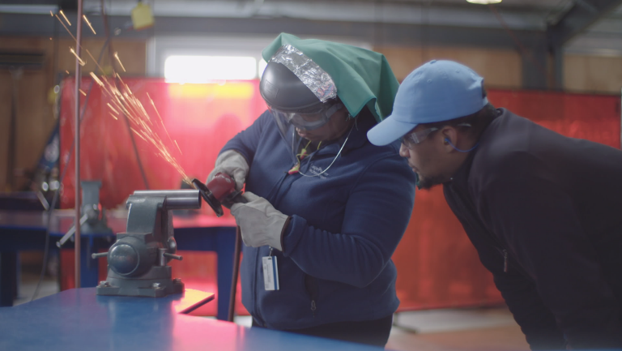
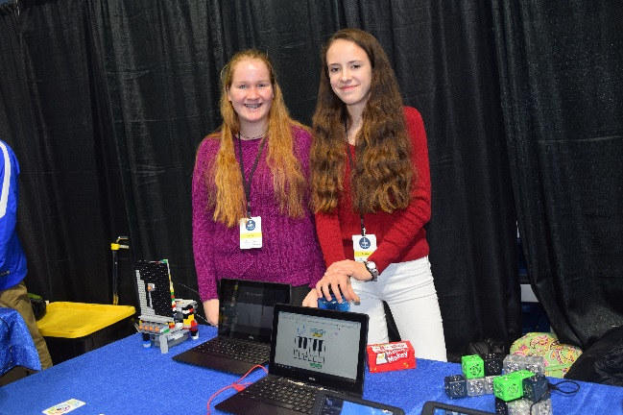
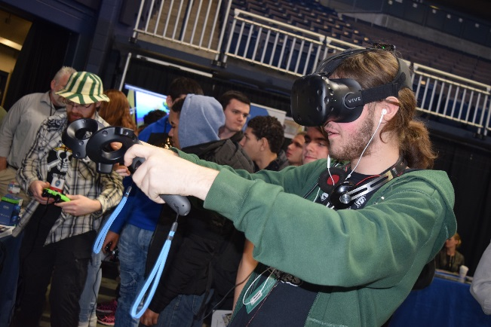
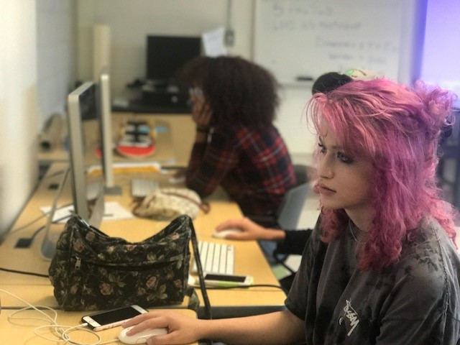
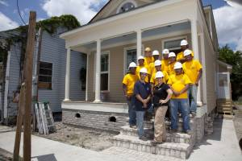
Join PrepareRI!
Join our newsletter
www.prepare-ri.org/newsletter
Come to the PrepareRI Summit on 10/13
www.prepare-ri.org/summits

Slide 12
Career Coordinator Job Responsibilities:
Serve as the designated point person for all internal and external-facing communication regarding the coordination of work-based learning experiences for students. This would include communications from the Governor’s Workforce Board (GWB), the Statewide Career Readiness Intermediary (Skills for Rhode Island’s Future), employers, RIDE, community-based organizations, and other pertinent groups.
Prepare students for work-based learning experiences that meets the Governor’s Workforce Board’s Guidance on Work-Based Learning (see prepare-ri.org/wbl). That guidance defines quality work-based learning as rigorous, relevant, reflective, interactive, and integrated.
Ensure distribution and submission of all forms and required documentation.
Collaborate with teachers, school counselors, administrators and other school personnel to ensure that work-based learning experiences become embedded in the school culture.
Notes:
Liz

Slide 13
Promote an increased awareness of the value of essential career skills and their critical connection to employability while reinforcing the positive impact these skills can have on their own performance during the work-based learning experience. These essential skills include: collaboration and teamwork; communication; critical thinking and problem solving; initiative and self-management; and professionalism.
Work with school personnel to determine the degree of individual support, training, and coaching that will be needed to ensure that students are adequately prepared to participate in all facets of a work-based learning experience.
Identify and address any challenges and barriers, work to find solutions, and mediate situations when appropriate.
Identify and address any challenges and barriers, work to find solutions, and mediate situations when appropriate.
Notes:
Liz

Slide 14
Continue to provide support for students by meeting with them (individually or in small groups) to provide additional information regarding local work-based learning opportunities and programs.
Collect, interpret and analyze data relevant to improving work-based learning opportunities for students.
Promote and support career and technical education programs while increasing the integration of work-based learning into the programs and the culture of the school.
Participate in training sessions and attend meetings face-to-face or virtually that are scheduled by RIDE, the statewide intermediary (Skills for Rhode Island’s Future), and/or the PrepareRI Ambassadors.
Notes:
Liz

Slide 15
Welcome to the Future Forward
Career Coordinators’ Network!
www.prepare-ri.org/career-coordinators
On the horizon….
Creating a social media presence!
Your ideas and support are appreciated!
Notes:
Liz

Slide 16
Skills for RI’s Future
Skills for RI’s Future (SkillsRI) is Rhode Island’s youth career readiness intermediary
Key roles:
Managing the PrepareRI Internship Program
Helping connect schools and businesses
More information about SkillsRI’s connection to career coordinators at the October career coordinators meeting

Slide 17
WaterFire Presentation

Slide 18
Break

Slide 19
Work-Based Learning (WBL)
Why is WBL important?
Rhode Island’s WBL goals
Guidance from Governor’s Workforce Board (GWB)
RI is one of the nation’s leaders on WBL
This makes your work exciting and important
It also means there will be growing pains

Slide 20
Key WBL documents
GWB Work-Based Learning Guidance
Guidance memo
Standards tables
Legal questions
RIDE’s Work-Based Learning FAQ
Builds on the GWB Guidance to answer commonly-asked questions. Will be updated as needed.
All available at www.prepare-ri.org/wbl or www.prepare-ri.org/career-coordinators

Slide 21
What is WBL?
Internship: A position for a student or trainee to work in an organization, sometimes without pay, to gain work experience, satisfy requirements for a credential, and/or gain course credit.
Apprenticeship: Highly-formal job training experience that involves studying with a master of the trade on the job.1
Service-learning: A program or project which combines community service with an outside organization with a structured opportunity for reflection about that service, emphasizing the connections between service experiences and academic learning.
School-based enterprise: Students produce and sell goods or services in the school and learn about business skills and entrepreneurship. This may be part of an entrepreneurship course, and a business professional may serve as a mentor and advisor for the enterprise.
Industry project: Individual, group, or class-wide projects in which students address a real-world, industry-focused question or problem with the guidance of industry professionals.

Slide 22
Quality Standards
Rigorous: Skill-based, and tied to measurable outcomes. The experience should allow a student to gain measurable skills, whether those be essential skills (also known as professional skills, soft skills, or 21st century skills) or hard technical skills. The entire activity, including corresponding classroom time, should encompass a minimum of 80 hours.
Relevant: Connected to a student’s interests, as indicated in his/her Individualized Learning Plan (ILP) and to the real world of work. Projects and tasks should mirror those that exist in a real workplace, and should align to high-wage, high-demand industries in Rhode Island.
Reflective: Engages the student in reflection and analysis throughout and after the experience, including guided self-reflection (ex. through the ILP process) and meaningful evaluations from the industry professionals. In this process, students should connect the work-based learning experience to their academic work as well as future professional and educational goals.
Interactive: Providing multiple and extended opportunities for students to interact with industry professionals, whether as supervisors, mentors, advisors, or collaborators.
Integrated: Connected with the student’s school-based curriculum. A work-based learning experience is a practical application of academic and/or technical learning and should allow the student to practice the theory learned in the classroom in a real-world setting.

Slide 23
Essential Skills
Collaboration and teamwork: Works effectively within and contribute to teams, learns from and works collaboratively with others, shows adaptiveness and flexibility, and effectively negotiates conflict.
Communication: Listens actively and articulates and presents information clearly and effectively in written, visual, and verbal forms.
Critical thinking and problem solving: Distills and analyzes information, makes judgements based on evidence, and uses data and information to solve problems.
Initiative and self-management: Works independently as needed, monitors and prioritizes his/her own time and tasks, takes initiative to solve problems as appropriate, and employs persistence to take tasks to completion.
Professionalism: Follows and can articulate workplace norms such as punctuality, appropriate workplace communication and interactions, and professional dress.

Slide 24
Group Discussion
Groups of 5
Reading
Each person in the group reads the standards table for one of the five types of WBL
Sharing
Each person describes their assigned type of WBL
Discussing and clarifying
Discuss the standards with your group
Use the GWB Guidance and RIDE FAQ to answer questions
Share best practices
Write down unanswered questions
We’ll compile questions we couldn’t answer today and provide answers in an updated FAQ document

Slide 25
Questions
In the survey we send out afterward, please let us know what additional questions you have. We will update the FAQ based on those questions.

Slide 26
Closing
Fill out survey
Survey will be sent this week
Next meeting
Tuesday, October 23, 8:00 – 10:00 a.m.
Website for career coordinators
www.prepare-ri.org/career-coordinators
PrepareRI Summit
October 13, 8:30 a.m. – 2 p.m.
www.prepare-ri.org/summits

