Slide 1
Accountability 101
Rhode Island’s New Statewide System for School Accountability
[March 7, 2018 Draft]
Notes:
This is an overview of Rhode Island’s proposed statewide accountability system. RIDE is currently updating the plan following feedback from US ED. We hope to get approval following this round of updates.

Slide 2
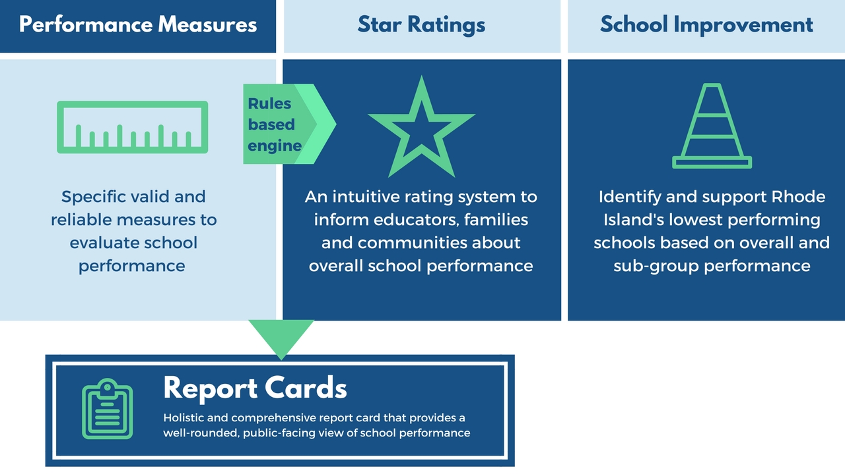
What are the components of Rhode Island’s Accountability system?

Slide 3
What’s new in Rhode Island’s Accountability system?
Rhode Island’s accountability system has updated indicators.
Rhode Island will use star ratings, which are clear and user-friendly.
This is a rule-based classification system that combines all indicators through norm- and criterion-based rules to determine star ratings.*
*By contrast, index systems sum points across all indicators.

Slide 4
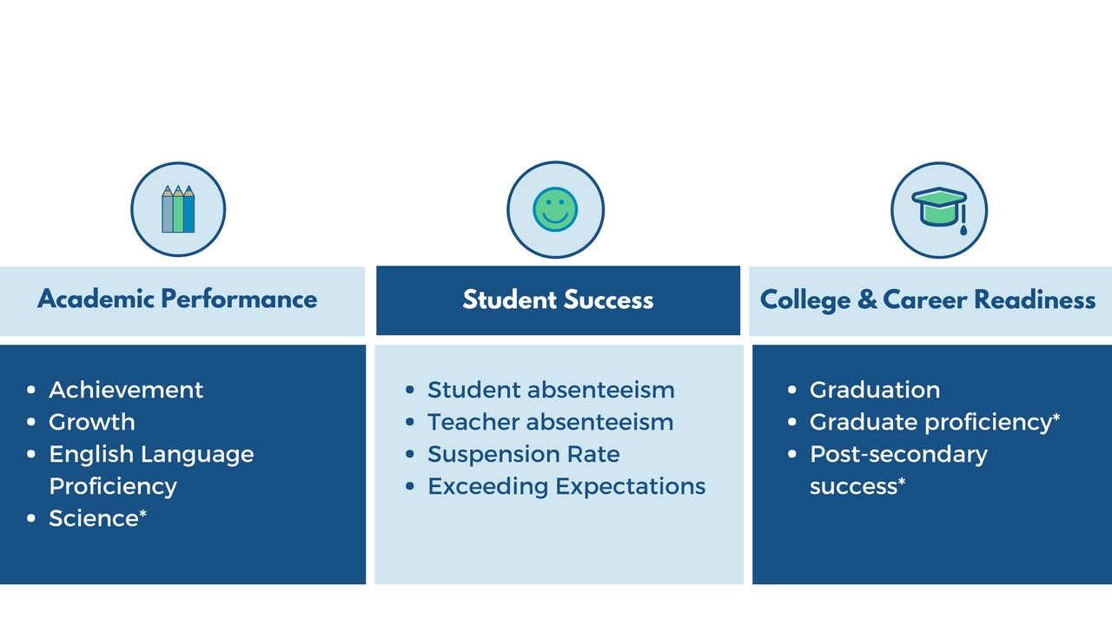
What measures will we use to evaluate school performance?
*Science Proficiency, Graduate Proficiency, and Post-Secondary Success will be added in future years.

Slide 5
Academic Performance Measures
Component | Metric(s)/Tools | Students Included | Years Included | Notes
Achievement | RICAS, DLM, SAT | All students; grades 3-8 and 11 | Two years | The lowest 5% of schools on these two measures will be identified for comprehensive support and improvement.
Growth | RICAS, PSAT/SAT | All students; grades 3-8 and 10-11
English Language Proficiency | ACCESS 2.0 | All students receiving English Learner (EL) supports | Two years | This measures growth based on a student’s English language proficiency in the prior year.
Science Proficiency* | RI NGSA | Grade 5, 8, and 11 | Two years | Testing the assessment Spring 2018; First operational test Spring 2019; Added to accountability system after Spring 2021 administration
*Science Proficiency will be added in future years.
Notes:
RIDE may add an additional year of data to meet the 20 student minimum for using an indicator.

Slide 6
Student Success Measures
Component | Metric(s)/Tools | Students Included | Years Included | Notes
Student Chronic Absenteeism | Student Attendance Data Collection | All Students | One year | The percent of students absent 10% of days or more
Teacher Chronic Absenteeism | Teacher Attendance Data Collection | All Students | One year | The percent of student courses taught by chronically absent teachers
Suspension Rate | Discipline Data Collection | All Students | One year | The out-of-school suspension rate
Exceeds Academic Expectations | RICAS, DLM, SAT | All students; grades 3-8, 10-11 | Two years | The percent of students who earn the top score on the state assessments

Slide 7
College & Career Readiness Measures
Component | Metric(s)/Tools | Students Included | Years Included | Notes
Graduation | 4-5-6 year composite graduation rate | High school only. All students in the applicable 9th grade cohorts | One year (three cohorts) | Equal weights to 4-, 5-, and 6- year graduation rates
Graduate Proficiency* | RIDE-approved English language arts and mathematics assessments | All high school graduates | One cohort | Measures percent of students demonstrating proficiency until 2021; Beginning 2022, transitions to Commissioner's Seal indicator
Post-Secondary Success* | CTE credentials, dual and concurrent college credits, AP tests | All high school graduates | One cohort | Measures the percent of students who have one or more credential or college credit; Beginning 2022, will include seal of biliteracy and pathway endorsements
*Graduate Proficiency, and Post-Secondary Success will be added in future years.

Slide 8
Scoring Individual Measures
Based on a combination of norm and criterion factors, we set cut scores to take a measure and turn it into a number of points.
Scored from 1 to 3 Points: | Growth, Exceeds Expectations, Student Chronic Absenteeism, Teacher Chronic Absenteeism, Suspension
Scored from 1 to 4 Points: | Achievement, English Language Proficiency
Scored from 1 to 5 Points: | Graduation
Out of School Suspensions Per 100 Students | Suspension Points
>= 10 OR No data reported | 1 Point
>= 5 AND < 10 | 2 Points
< 5 | 3 Points
Suspension Example:
Notes:
The number of points per indicator was determined based on what could meaningfully differentiate schools. Some indicators span larger ranges, allowing for more differentiation than others.
These are the actual cuts for the suspension indicator. Cuts for Student Chronic Absenteeism and Graduation are in the appendix.
Achievement, Growth, and Exceeds Expectations: Rhode Island is switching to the RICAS, DLM, and PSAT/SAT assessments in 2017-18 and will re-set cuts once one and two years of data are available.
Teacher Chronic Absenteeism: RIDE is collecting these data starting in 2017-18. We will set cuts after the first year of data are available.
English Language Proficiency: Rhode Island uses the ACCESS 2.0 assessment which is a new test as of 2015-16 and has new score reporting starting in 2016-17. 2015-16 scores were provided in both the new and old scoring systems but reported in the old system. RIDE set cuts based on 2015-16 to 2016-17 growth, but may adjust the cuts once we have two years of growth data.

Slide 9
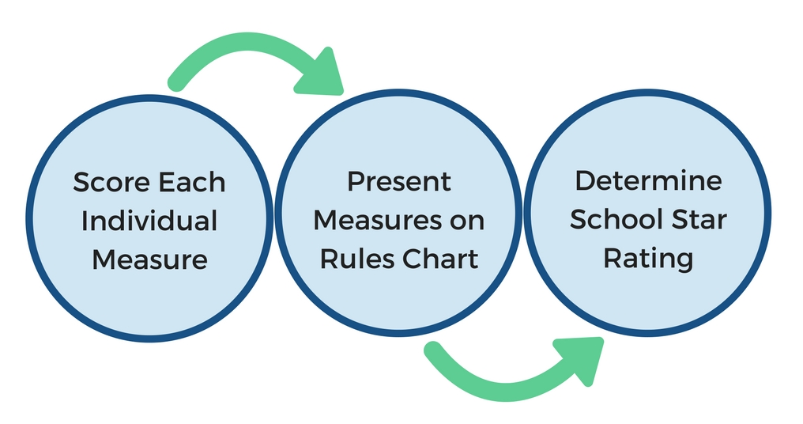
How are School Star Ratings Determined?
Notes:
We’ll look at the rules chart in just a moment.

Slide 10
How are School Star Ratings Determined?
Star Rating Step | Description
1) Score Individual Measures | All schools receive a certain number of points for each measure based on the school’s performance (as an index or percentage) on that measure.
2) Present Measures on a Rules Chart | Each school receives a dashboard of their scores for all measures. This dashboard, compared to one overall number, which will highlight positive performance and help focus on areas for improvement.
3) Determine Overall Star Rating | A school receives the highest star rating in which they meet all criteria for that star performance level.

Slide 11
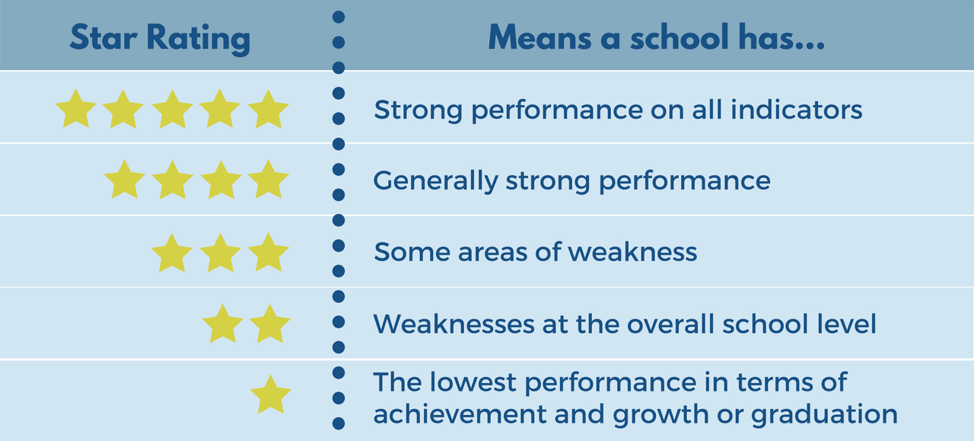
What do School Star Ratings mean?

Slide 12
School Star Rating Performance Levels - Overview
Achievement – ELA and Math (Max. 8 Points) | Growth – ELA and Math (Max. 6 Points) | English Language Proficiency (Max. 4 Points) | Exceeds Expectations, Absenteeism, & Suspension (Max. 15 Points) | Graduation Rate (Max. 5 Points) | # of Low-Performing Subgroups | Star Rating
6-8 points (3-4 per subject) | 4-6 points (2-3 per subject) | 3-4 points | 12-15 points | 4-5 points | None | ★★★★★
5-6 points (2-4 per subject) |  | 2 points | 10-11 points |  | 1 subgroup | ★★★★
7-9 total points |  |  | 7-9 points | 3 points | 2+ subgroups | ★★★
5-6 total points |  | 1 point | 5-6 points | 2 points |  | ★★
2 points | 2 points |  |  | 1 point |  | ★
*Science Proficiency, Graduate Proficiency, and Post-Secondary Success will be added in future years.
Notes:
This is our proposed rule system, which we may adjust as we get indicator data for the first year. The distribution of points for ‘Exceeds Expectations, Absenteeism, & Suspension’ especially, may change once we have more data. The chart will also be adjusted as we add indicators.
The chart represents our intention to stress Achievement and Growth for struggling schools, while other indicators differentiate at the middle and high-performing levels. A 5 star school must be excellent across the board.
Schools get the highest level for merged cells.

Slide 13
Pick the number of points your school earned in each column…
This is an elementary school.
Achievement – ELA and Math (Max. 8 Points) | Growth – ELA and Math (Max. 6 Points) | English Language Proficiency (Max. 4 Points) | Exceeds Expectations, Absenteeism, & Suspension (Max. 15 Points) | Graduation Rate (Max. 5 Points) | # of Low-Performing Subgroups | Star Rating
6-8 points (3-4 per subject) | 4-6 points (2-3 per subject) | 3-4 points | 12-15 points | 4-5 points | None | ★★★★★
5-6 points (2-4 per subject) |  | 2 points | 10-11 points |  | 1 subgroup | ★★★★
7-9 total points |  |  | 7-9 points | 3 points | 2+ subgroups | ★★★
5-6 total points |  | 1 point | 5-6 points | 2 points |  | ★★
2 points | 2 points |  |  | 1 point |  | ★
*Science Proficiency, Graduate Proficiency, and Post-Secondary Success will be added in future years.
Notes:
This is our proposed rule system, which we may adjust as we get indicator data for the first year. The distribution of points for ‘Exceeds Expectations, Absenteeism, & Suspension’ especially, may change once we have more data. The chart will also be adjusted as we add indicators.
The chart represents our intention to stress Achievement and Growth for struggling schools, while other indicators differentiate at the middle and high-performing levels. A 5 star school must be excellent across the board.
Schools get the highest level for merged cells.

Slide 14
… And your star rating is the lowest row where you circled something.
Achievement – ELA and Math (Max. 8 Points) | Growth – ELA and Math (Max. 6 Points) | English Language Proficiency (Max. 4 Points) | Exceeds Expectations, Absenteeism, & Suspension (Max. 15 Points) | Graduation Rate (Max. 5 Points) | # of Low-Performing Subgroups | Star Rating
6-8 points (3-4 per subject) | 4-6 points (2-3 per subject) | 3-4 points | 12-15 points | 4-5 points | None | ★★★★★
5-6 points (2-4 per subject) |  | 2 points | 10-11 points |  | 1 subgroup | ★★★★
7-9 total points |  |  | 7-9 points | 3 points | 2+ subgroups | ★★★
5-6 total points |  | 1 point | 5-6 points | 2 points |  | ★★
2 points | 2 points |  |  | 1 point |  | ★
*Science Proficiency, Graduate Proficiency, and Post-Secondary Success will be added in future years.
Notes:
This is our proposed rule system, which we may adjust as we get indicator data for the first year. The distribution of points for ‘Exceeds Expectations, Absenteeism, & Suspension’ especially, may change once we have more data. The chart will also be adjusted as we add indicators.
The chart represents our intention to stress Achievement and Growth for struggling schools, while other indicators differentiate at the middle and high-performing levels. A 5 star school must be excellent across the board.
Schools get the highest level for merged cells.

Slide 15
Federal law (ESSA) requires identification of RI’s lowest performing schools.
A low performing school will be identified as a 1-Star School in need of “Comprehensive Support and Improvement” if:
Academic achievement and growth are in the bottom 5% of both measures;
Graduation rate is less than 67%; or
The school has the lowest score for all applicable non-graduation indicators, and one or two points for graduation if applicable.*
Achievement
Growth
Low performing schools must authentically engage stakeholders through a “Community Advisory Board” and undergo a “School Redesign” if the school does not improve.
* This is a new element of our most recent plan based on feedback from US ED. Not yet approved.
Notes:
We wrote criterion 3 in response to feedback from US ED this week. It is not yet approved.

Slide 16
ESSA also requires Identification of RI schools with low performing student subgroups.
To help make sure we support every student, RIDE will identify that a school has a consistently under-performing subgroup in need of “targeted support and improvement” if that subgroup:
Performs at a 1-star level.*
RIDE will identify that a school has a low-performing subgroup in need of “additional targeted support and improvement” if that subgroup meets the criteria for a school in need of comprehensive support and improvement:
Performs at a 1-star level and a) is at the same level as the bottom 5% of all schools in both Achivement and Growth, b) has a graduation rate of less than 67%, or c) has the lowest score for all applicable non-graduation indicators and one or two points for graduation, if applicable.*
A school will also be identified as in need of “Comprehensive Support and Improvement” if any subgroup meeting the minimum n-size is identified for additional targeted support and improvement for 4 consecutive years.
* Pending approval following feedback from US ED.

Slide 17
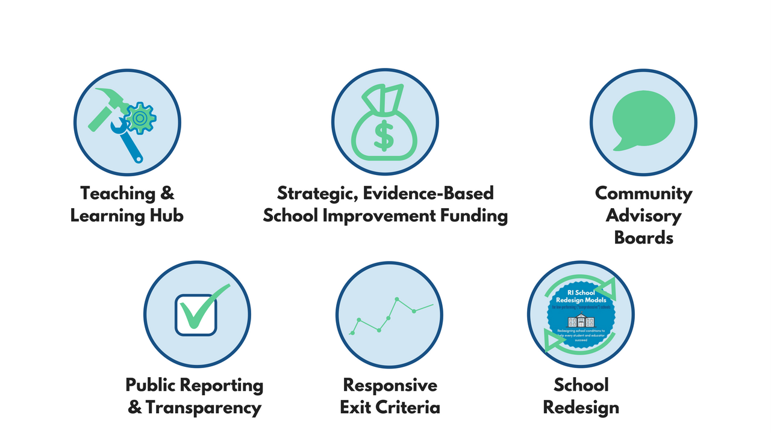
How will RI support low performing schools?
Notes:
- A cultivated hub of evidence-based school improvement strategies, frameworks and tools, and proven providers
- Flexible federal funding to support evidence-based school improvement initiatives
- Community advisory boards to provide authentic guidance and feedback on school improvement efforts
- School redesign, including public re-designation of schools
- Exit criteria that rewards clear improvement

Slide 18
Accountability 101
Rhode Island’s New Statewide System for School Accountability
Questions?

Slide 19
Accountability 101
Rhode Island’s New Statewide System for School Accountability
Appendix

Slide 20
Scoring Individual Measures – Student Chronic Absenteeism
Elementary and Middle Schools
Percent Chronically Absent (Student) | Student Chronic Absenteeism Points
>= 15 OR No data reported | 1 Point
>= 5 AND < 15 | 2 Points
< 5 | 3 Points
High Schools
Percent Chronically Absent (Student) | Student Chronic Absenteeism Points
>= 20 OR No data reported | 1 Point
>= 10 AND < 20 | 2 Points
< 10 | 3 Points

Slide 21
Scoring Individual Measures – Graduation Rate
Composite Graduation Rate = 1/3 each: 4-year graduation rate, 5-year graduation rate, and 6-year graduation rate
Scores of 2-4 points use the composite graduation rate. Excellent and very poor 4-year graduation rates correspond to five and one points, respectively. This aligns with Rhode Island’s long-term goals as well as federal requirement that schools with less than 67% graduation rates be identified as in need of comprehensive support and improvement.
Composite Graduation Rate | Graduation Points
<= 67% 4-Year Graduation (not composite) | 1 Point*
< 80% | 2 Points
>= 80% AND < 90% | 3 Points
>= 90% | 4 Points
>= 95% 4-Year Graduation (not composite) | 5 Points
* Also identified for comprehensive support and improvement
Notes:
Levels 2-4 are all based on the composite graduation rate. Level 5 represents RI’s long-term goal. Level 1 represents the federal requirement of identifying schools who fail to graduate a third or more of their students for comprehensive support and improvement.

Slide 22
Exiting Identification
Additional Targeted Support and Improvement (Low-Performing Subgroup)
A school will no longer be identified as in need of targeted support and improvement if (1) the positive change in performance for that subgroup exceeds the statewide change in performance for that same subgroup and (2) the subgroup no longer falls inside the parameters from when they were identified.
Schools identified as Targeted Support and Improvement in the Lowest Performing Subgroups category for four consecutive years will be re-designated as in need of Comprehensive Support and Improvement
Comprehensive Support and Improvement
A school identified due to low achievement and growth will no longer be identified as in need of comprehensive support and improvement if the school does not fall into the lowest 5% of all schools in achievement and growth for both the (1) current year and (2) the year they were identified.
A school identified due to failure to graduate at least one third or more of their students may exit once they graduate at least two thirds of their students.
A school identified with the lowest score for all non-graduation indicators and one or two points for graduation if applicable may exit once they no longer meet the criteria for the lowest score in all areas for the year in which they were identified and the current year.
Schools identified as in need of Comprehensive Support and Improvement for four consecutive years will be re-designated as in need of school redesign.*
Notes:
Schools identified due to multiple criteria must meet the requirements for exit for all criteria in which they were identified.

Slide 23
School Redesign
Any LEA with schools identified as in need of Comprehensive Support and Improvement may, with their designated Community Advisory Board, choose to initiate a School Redesign.
An LEA with schools identified as in need of Comprehensive Support and Improvement for four (or in some cases, two) consecutive years must initiate a School Redesign.
After initiation of School Redesign, the school will be classified as “New School Redesign” instead of Comprehensive Support and Improvement until the school meets exit criteria for up to 2 years.

Slide 24
