Slide 1
PrepareRI for All
“Awareness, Collaboration, & Access to all PrepareRI Components”
Jane Slade
Education Specialist/Secondary Transition
Office of Student, Community, and Academic Supports
Rhode Island Department of Elementary & Secondary Education
jane.slade@ride.ri.gov
Cindy VanAvery
PrepareRI Ambassador
Director of Transition & Vocational Services
Northern Rhode Island Collaborative
cvanavery@nric-ri.org

Slide 2
Learning Objectives
Attendees will gain knowledge of:
Awareness-
PrepareRI Components & Special Education
Inclusionary practices
Perception vs. Barriers
Access- PrepareRI for all
Data Review (formal & informal)
Perception vs. Barriers
Collaboration- CTE/Special Educators/Business
Necessity
Next Steps
Tools-
Infrastructure Analysis
Self Assessment (NTACT)

Slide 3
What does prepare ri mean for schools?
PrepareRI aims to create a K-12 education system that is aligned with the demands of colleges and employers. Making this goal a reality involves coordinated effort from teachers, school leaders, superintendents, and all stakeholders in Rhode Island's education system. PrepareRI involves:
All high school students should have access to a high-quality work-based learning experience in a high-skill, high-demand career field.
All high school students should graduate with postsecondary credit. This postsecondary credit could be a college credit (earned through dual enrollment or the Advanced Course Network) or an industry credential (earned through a career and technical education program). All students also have the option to pursue a Pathway Endorsement.
All elementary and middle school students will have access to career exploration programming.
All students will have a personalized Individual Learning Plan (ILP) to guide their coursework throughout their K-12 experience.
Career and technical education (CTE) will be expanded and aligned to high-demand industries.
Notes:
If you missed the first summit or if you are new.
All live links.
Special Educators…. The word “All”; Special Ed Directors not included at first summit; hyper drive to get them up to speed.

Slide 4
PrepareRI will restructure the entire talent pipeline in Rhode Island, from kindergarten to career.
Our goal is that, by 2020:
All students will have career exploration opportunities beginning in elementary and middle school, and individual learning plans (ILPs) based on their unique strengths and interests
All high school students will graduate with college credit or an industry credential
All high school students will have access to a work-based learning experience, such as an internship in a relevant career field
All career pathway programs will be aligned to Rhode Island’s high-demand career fields
Notes:
Funding came from….. One pager link
High Demand – six? What are they?
First bullet we rocked it in Special Ed.
We know bullet number 2 we weren’t sure what these were?

Slide 5
The average number of hours each of us will work from age 22 until age 67.
90,000
Notes:
The importance of restructuring our mantra and culture for K-12 System

Slide 6
What we know is important…
Self-Determination
Positive School Climate
Key Relationships with Caring Adult Allies
Demanding, creative instruction – with effective and appropriate supports
Students who “get the connection” between school and “the REAL WORLD”
Notes:
These are things that we know are important for all kids….
As we restructure lets not lose!
We didn’t want to lose these things!

Slide 7
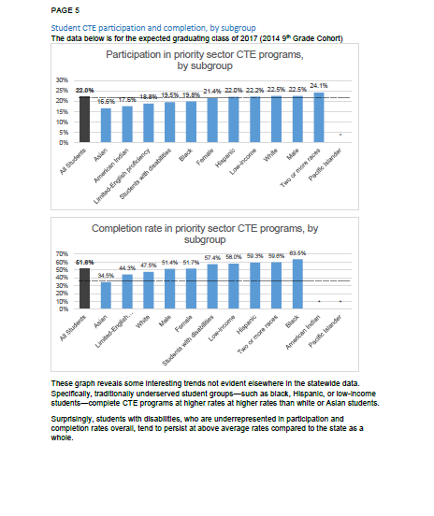
RI Data & Special Education
Notes:
What we are thinking?
Let’s Look at RI Data?
Perception that we didn’t have youth with disabilities included.
Collecting data…. We are building a better system to collect and analyze the data.

Slide 8
From the Literature

Slide 9
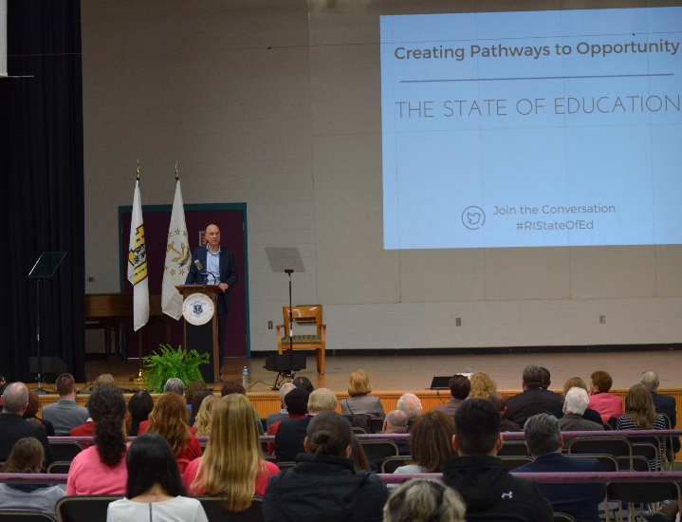
The need for collaboration: what we know
Related to career preparation, youth with disabilities:
are less likely than their peers without disabilities to receive an academically rigorous curriculum in high school;
experience national graduation rates of only 63%, compared to 83% for students without disabilities.
Commissioner Wagner delivers the 2017 State of Education in Rhode Island address (May 8, 2017)
Notes:
Run through this, but don’t spend a lot of time on!

Slide 10
The need for collaboration: what we know
Estimated 85% of students with disabilities should be able to master general education content if they receive adequate supports, including accommodations, modifications, and counseling
When given demanding curricula and instruction, students with disabilities tend to have fewer absences and have better postsecondary outcomes
With the right supports, the path to meaningful careers is attainable for all youth, including those with disabilities.

Slide 11
Theobald, R., Goldhaber, D., Gratz, T., & Holden, K. (2017). Career and technical education, inclusion, and postsecondary outcomes for students with disabilities. Seattle, WA: Center for Education, Data & Research.
“We find generally weak relationships between CTE enrollment in any particular grade and intermediate and postsecondary outcomes for students with disabilities, though we replicate earlier findings that students with disabilities who are enrolled in a “concentration” of CTE courses have higher rates of employment after graduation than students with disabilities who are similar in other observable ways but are enrolled in fewer CTE courses”
“We also find consistently strong evidence that students with disabilities who spend more time in general education classrooms experience better outcomes—fewer absences, higher academic performance, higher rates of grade progression and on-time graduation, and higher rates of college attendance and employment—than students with disabilities who are similar in other observable ways but spend less time in general education classrooms.”
Notes:
Research we pulled these from

Slide 12
Work-Based Learning (Preaching to the Choir!)
Substantial evidence exists to support the value of WBL as a critical educational intervention effective in improving the postsecondary employment of youth with disabilities
providing students with teamwork or cooperative learning experiences comparable to those they would encounter in community or work settings,
increasing the meaning of academic learning through real-world applications, and
using experiential learning (e.g., work-based learning opportunities) to make these many connections

Slide 13
Where we started in RI…
Baseline – CTE Data
Awareness
Perception- Barriers, etc…
Knowledge – lack/varied
Messaging Structure
Notes:
Fall Summit
RIDE Specialists attend meetings – Nicole, Paul, Cali
ARIASE – Knowledge; that many had no knowledge
OSCAS - Directors Briefing
Messaging Structure
RI Transition Institute – Cali presenting; Transition Advisory (250 Special educators hearing the message)
Not separate pathways for youth with disabilities but inclusive; on and off ramps

Slide 14
What are Special Education Directors telling us?

Slide 15
What we heard!
Range of Knowledge about CTE/High School Graduation Requirements, Dual Enrollment, & ACN
They don’t want to be left out or late to the party
They want to be included and engaged in these conversations for all youth at a local and state level
They want to have more opportunities and access for students
All Educational Leaders need to have expectations that all youth regardless of ability have equal access to pathways.
- RI Superintendent
Notes:
Pathways being rolled and created in almost everyone of our districts.
Level of urgency to support all kids

Slide 16
What are CTE Instructors telling us?
By and large-
These professionals are open and receptive to having diverse students, including those with disabilities, in their courses and programs.
They are optimists who believe everyone has talents to contribute to our communities.
They fully understand the complex needs many youth face in our society today

Slide 17
Special Education Directors & CTE Instructors Concerns
Gap between many students’ basic academic skill levels and demands of courses
Insufficient support to students AND the CTE teachers serving them
Classes too full, too large & inadequately staffed
Teachers feeling ill-prepared; lacking essential tools and strategies re: accommodations, modifications, class-room management
Systemic constraints (e.g., “walls” between Gen Ed, Spec Ed, CTE, Counselors, & Administrators; poor communication; insufficient info re student strengths and needs; inadequate guidance of students into areas of interest)
Lack of professional learning
Funding challenges

Slide 18
What Special Education Students are telling us…
Access to demanding courses, with appropriate supports (esp. CTE classes)
Ways to discover their unique skills and talents
Better preparation in MS for the demands and culture of high school
Leadership opportunities
Authentic work-based learning experiences
Adult “allies” and champions
Chance to show people what they can contribute to the world
To be part of the action!

Slide 19
Strategies
What would address these concerns?
Co-teachers and paraprofessionals (similar to supports to Gen Ed)
More useful and timely information about individual students (ex. IEP at-a-glance; profiles)
Training and easy-to-use (“practical”) resources re accommodations/modifications
Time for collaborative planning; shared learning across partners
Making CTE course enrollment meaningful for degree completion as well as for career development (renewed perception of CTE as rigorous as other academic subjects; not merely an “elective.”) Supported by Solberg and others
Increasing collaboration among community organizations and employers – and the school
Collaborative teaching: Co-teachers and paraprofessionals (similar to supports to Gen Ed)
Face to Face time with content leaders

Slide 20
Courses (Delaware)
Successfully Serving Students with Disabilities in Our Schools: A Strengths-Based versus Deficits-Based Approach
Reaching the Reluctant Student by Infusing Career Awareness and Exploration into Academic Instruction
Ensuring that Delaware Students with Disabilities Access and Thrive in Career and Technical Education Courses -- and Complete Career Pathways
Middle School Teachers as Fortune-Tellers: Helping Students Envision their Futures and Prepare for High School and Beyond
Supporting Diverse Learners, including Students with Disabilities, in Career and Technical Education Coursework: Getting to Know these Students.
Supporting Diverse Learners, including Students with Disabilities, in Career and Technical Education Coursework: Incorporating the Principles of Universal Design for Learning into your Courses
Notes:
Diverse Participants
CTE
Special Educators (all grades)
General Educators (all grades; all subjects)
School Counselors
ELL teachers
Administrators
Paraprofessionals
Strategies Delaware put inplace

Slide 21
What’s top of mind for Special Educators/CTE Instructors around supporting students with disabilities to be successful in career pathway courses?
Notes:
Collaboration!

Slide 22
Employers Know the Need Talent
Special Educators know Supports, Accommodations, Modifications
CTE Educators know the Industries and how to build skills
Why does it make perfect sense for CTE and Special Educators to collaborate?

Slide 23
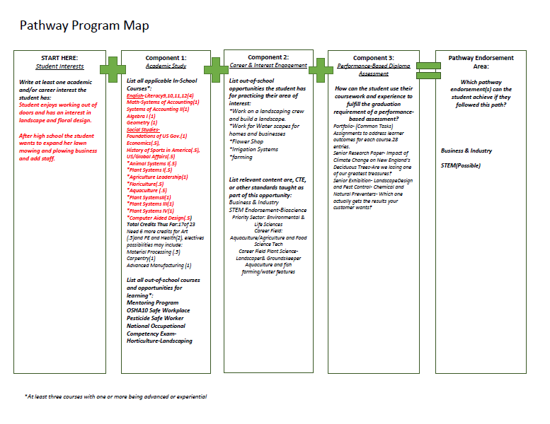
Tools!
Notes:
Recently draft of a tool that Special Ed.
How to conceptualize pathway endorsements

Slide 24
Notes:
NTACT Tool at a District level w/Evidenced Based practices!
Worth taking a look at. District could use to identify deficits and strengths within programming

Slide 25
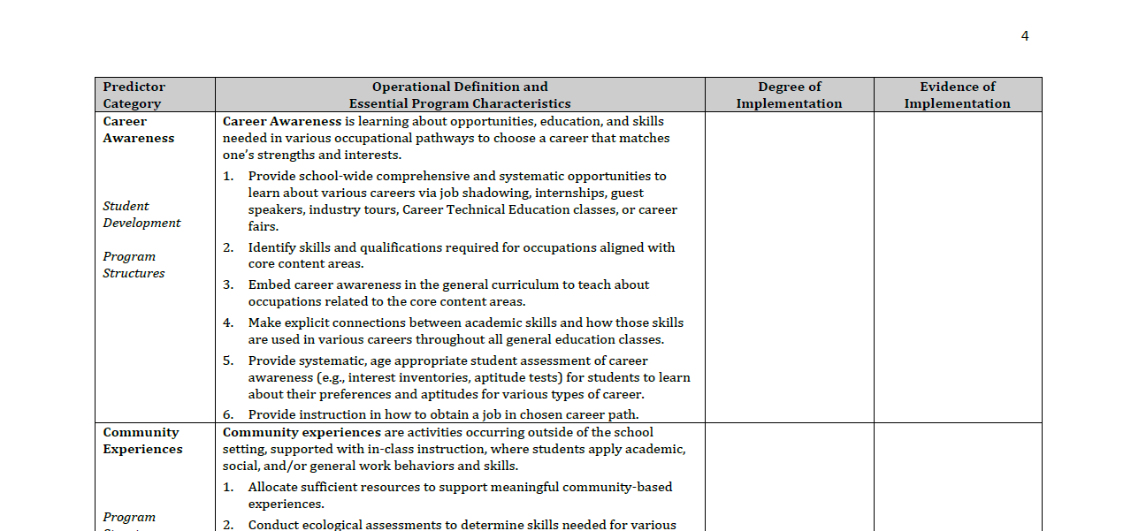

Slide 26
National Data Tool!
Notes:
Nevada & Delaware utilized this tool to resture state CTE/Special Education.
This tool fostered relationships between CTE/ College & Readiness/Special Ed…. Department of Ed

Slide 27
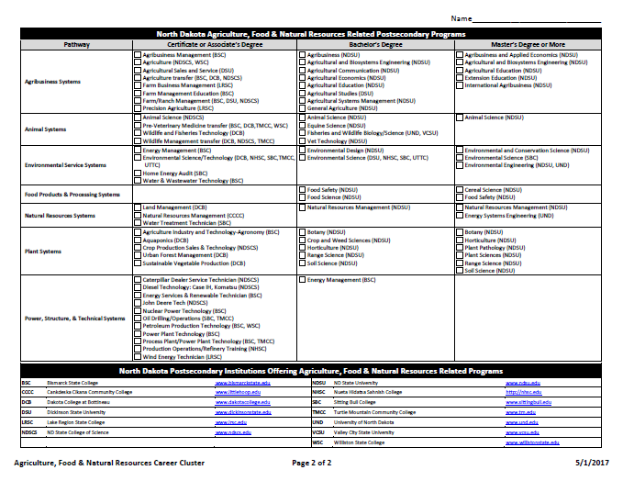
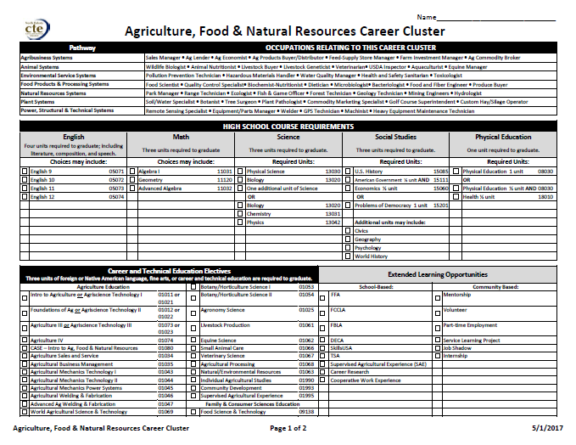
North Dakota! https://www.nd.gov/cte/services/career-clusters/plans-of-study/AllCareerClusterPlansOfStudy.pdf

Slide 28
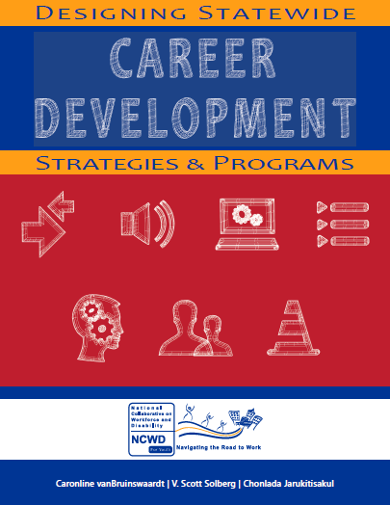
Resources!

Slide 29
Providing a Big Picture of PrepareRI so diverse stakeholders can see how all the components fit together!
Premise: All education is related to career development
Begins in pre-school (perhaps even earlier!)
Reflects self-determination, person-centered approach, high expectations of all stakeholders, importance of champions, and cross-agency collaboration
Transition enables access to opportunities afforded to ALL children and youth
The imperative for cross-disciplinary collaboration has never been greater
With the right supports, the path to meaningful careers is attainable for all youth, including those with disabilities.
College and Career Readiness should = transition focused education for ALL students

Slide 30
Questions? Thoughts? Discussion?
Notes:
Ask us a question?
Give us a thought
What’s one concern you still have?
Question, thought or concern

