Slide 1
PrepareRI College Readiness Project
A system-wide effort to prepare all students for college success
Brown Bag Presentation
July 20, 2020

Slide 2
Background
Preparing Rhode Island students for college.
The PrepareRI College Readiness Project represents a strategic partnership between K-12 education and Rhode Island’s colleges and universities to ensure that every student graduates from high school ready to enroll in credit-bearing coursework on a path to on-time college completion.

Slide 3
The 10-year trajectory of RI’s 2007-2008 freshman class
Disaggregation | High School Graduates | Enroll in Postsecondary | Complete Postsecondary
Full cohort (graphic above) | 81% | 72% | 34%
Free/Reduced Price Lunch | 73% | 63% | 19%
Students of Color | 73% | 66% | 21%
Multilingual Learners | 71% | 49% | 7%
Students with IEPs | 66% | 44% | 9%
Data notes: The denominator for all of these percentages is the students from RI’s 2007-2008 freshman class. The numerator is the percentage of who have completed each step at any point between 2008 to 2018. The postsecondary figures include any college or university nationwide (both 2-year and 4-year) that reports data to the National Student Clearinghouse. Analysis by DataSpark at URI.

Slide 4
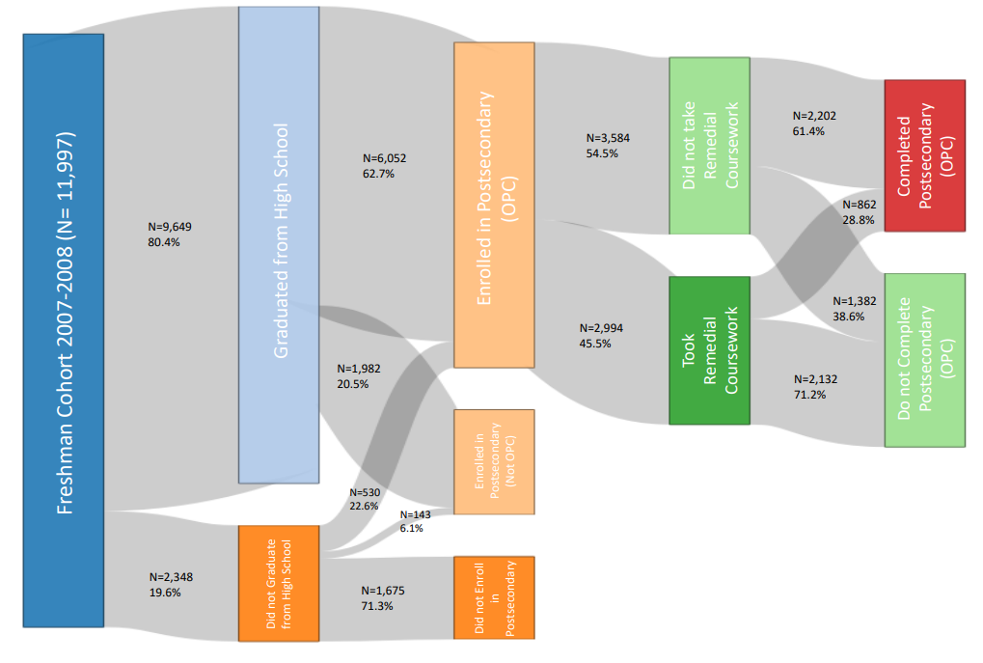
The impact of remediation on Rhode Island’s Freshman class of 2007/8

Slide 5
Readiness Project Workstreams
1.
Readiness
Academic Readiness
2.
Matriculation
Alignment of requirements
FAFSA completion efforts
3.
Communication
Transition to College eGuide
Major-aligned college credit
Proficiency strategies

Slide 6
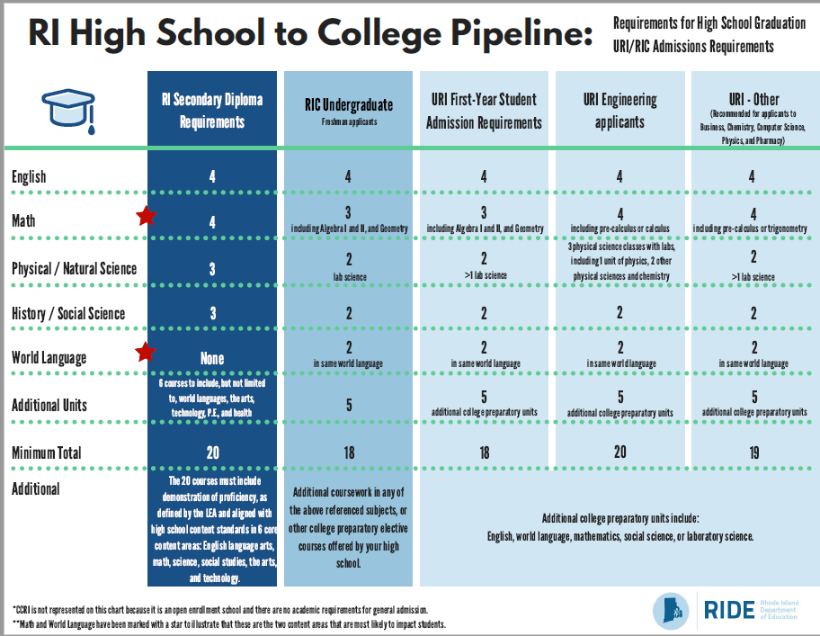
Alignment of Requirements
Problem: The Secondary graduation requirements and Public Postsecondary admission requirements are not currently aligned in Rhode Island.
Solution:
Phase 1: Provide a guidance chart on our current state to schools, students, and families so they are able to make informed choices.
Phase 2: Modify policies to better align the systems. To that end, two memos have been drafted outlining possible changes for both systems (K12 and Postsecondary).

Slide 7
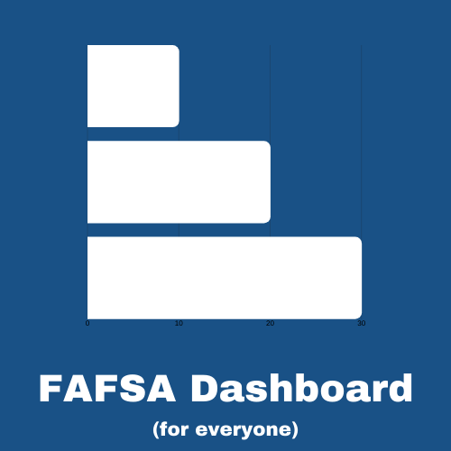
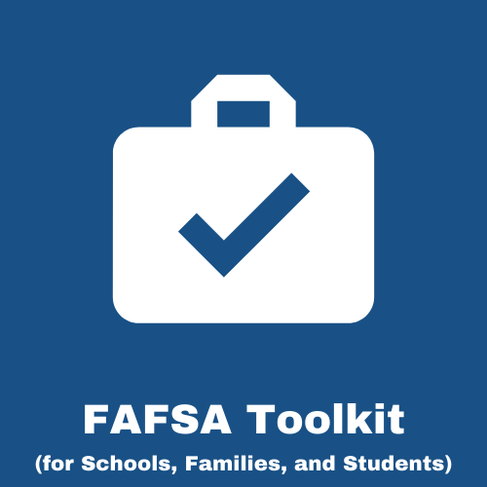
FAFSA Completion
Problem: Too few of our students are completing the FAFSA and missing out on federal funds to attend a postsecondary institution. Last year Rhode Island left over $4 million dollars in Federal Pell grants on the table.
Solution 1: Give students and schools biweekly updates on their completion rates through a public FAFSA completion dashboard | Solution 2: Provide students, schools, and families with resources to help them complete the application through a FAFSA toolkit | Solution 3: Help Counselors target students who have not completed through a secure online FAFSA Portal with student-specific info

Slide 8
PrepareRI College eGuide
High School
College
Problem: Many students struggle to navigate the transition from high school to college.
Solution: The PrepareRI College eGuide was developed to provide information about resources available to students in Rhode Island.
It includes sections on:
What you should be doing each year to get ready for college
When, where, and how to register for the PSAT, SAT, and ACT
Organizations that can help you get ready to apply to colleges
When and how to apply to all 11 colleges in Rhode Island
How to find money to pay for college
What other non-college opportunities are out there after high school
The full guide is available at www.prepare-ri.org/readiness

Slide 9
RISE tool
College
College majors and career clusters at all every college in Rhode Island
High School
CTE programs, pathway endorsements, and advanced coursework
Exposure to the tool via Individualized Learning Plans (ILPs)
Career
Jobs and earning potential based on real wage data in Rhode Island
Middle School
Problem: Students are taking advantage of dual enrollment opportunities in Rhode Island, but they may not be aligned to their long-term plans.
Solution: We have mapped the educational opportunities from middle school to high school to college to career in Rhode Island, so students can see the vertical alignment of their chosen path and understand their long-term prospects.
Updates:
We have expanded the mapping spreadsheet to include RIDE-approved CTE programs.
We have expanded the mapping spreadsheet to include all eight private colleges in the in the state (dual courses are still pending).
The full spreadsheet is available on www.prepare-ri.org/readiness.

Slide 10
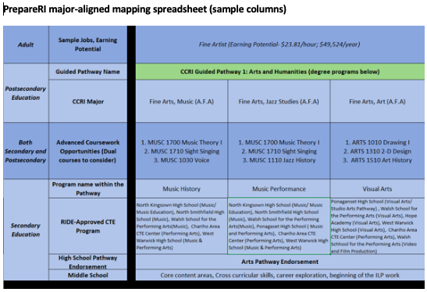

Slide 11
Academics - Readiness Project
The original six-school, 230 student pilot that launched in January of 2020 was designed:
with Carnegie Math Pathways content modules (a nationally renowned curriculum),
aligned to RIC's remedial Math 010 (a course that covers high school-level content),
utilizing the URI placement exam (the exam that both RIC and URI use),
This allowed students to "catch up" on required high-school level content so they were prepared to enter directly into credit-bearing coursework at CCRI, RIC, and URI.
Unfortunately, that developmental pilot was interrupted due to Covid19.

Slide 12
Readiness Project
Through the SAIL program, the 12th grade math pilot was able to expand to serve:
Rising and recently graduated (Class of 2020) Seniors in Math
Rising and recently graduated (Class of 2020) Seniors in Reading
Rising 9th graders in Math
Rising 9th graders in Reading

Slide 13
Readiness Project
Additionally, as part of the project we were able to offer students stipends, so they can "earn while they learn"
Students in the College Readiness courses can earn up to $750
Students in the High School Readiness courses can earn up to $250
They receive incentives for participation (daily attendance) and performance (growth on assessments)

Slide 14
Readiness Project
After a short ten-day registration window 2,756 students signed up,
making the Readiness Summer project larger than 70% of the LEAs in Rhode Island
Numbers at a Glance
9th grade: 1694 | 12th grade: 1062
Reading: 1204 | Math: 1552
Morning: 1598 | Afternoon: 1158
Urban/Urban Ring: 1563 | Suburban: 1164

Slide 15
Readiness Project
203 applications
75 offers
71
71 teachers were ultimately hired and completed 12 hours of professional development the week before instruction began (June 22-26) with WestEd.
They now each teach a morning and afternoon daily synchronous session, facilitate small group collaborative sessions, and host daily office hours and provide additional individualized support as needed.

Slide 16
Readiness Project
RIDE – concept, registration, project management
WestEd – content and course development, teacher PD, virtual learning platform
RIPL – student stipends and AI-powered chatbot "Yachty" to answer student questions
Highlander Institute – customer support (inbox management)

Slide 17
All deliverables can be found at
www.prepare-ri.org/readiness
OR open your phone’s camera, center on this image and it should bring you there directly:
We want to hear what you think!
If you have suggestions, please get in touch with Elizabeth.Texeira@ride.ri.gov

